Slide 1

Robert Green DevOps Practices Can Make You a Better Developer
Tue, 22 Oct | 3:40 PM – 4:30 PM
Beta Room

Slide 2
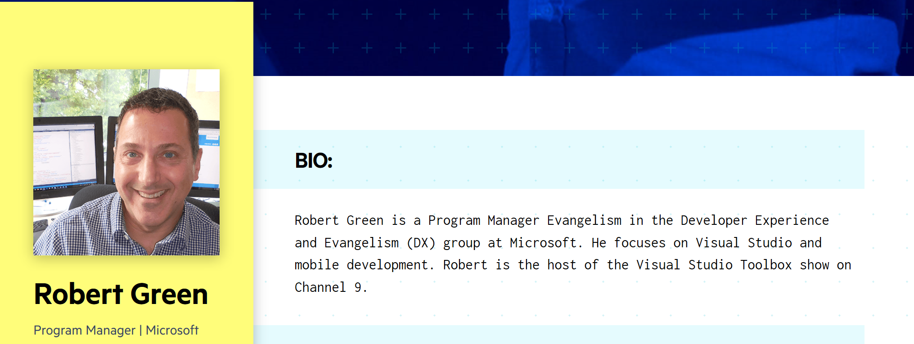
was
@rogreen_ms
rgreen2005@msn.com
https://channel9.msdn.com/Shows/Visual-Studio-Toolbox

Slide 3
Accelerating Delivery with DevOps
Develop
“
DevOps is the union of people, process, and products to enable continuous delivery of value to your end users.
”
DevOps
Operate
Deliver
Notes:
DevOps allows us to accelerate delivery, while still delivering reliable products and services
This is about bringing people together, through shared common goals, increased collaboration and a focus on improvement
Technology plays a key role in helping to execute a DevOps strategy by enabling teams to collaborate more, enhance productivity, facilitate experimentation and automate their processes from development, through to delivery and operations
It’s also about delivering value faster by increasing efficiency, eliminating waste and streamlining feedback back to developers to continuously improve the product
The result: better products, delivered faster, to happier customers
https://medium.com/@DonovanBrown_41367/dissecting-the-definition-69151da0435f

Slide 4
Innovation with oversight
Time spent
50%
Top performing DevOps companies spend more time innovating and less time “keeping the lights on”.
The result: better products, delivered faster, to happier customers by more engaged teams
30%
19.5%
20%
20%
15%
10%
10%
5%
5%
Top DevOps Performers
Low DevOps Performers
Notes:
According the 2018 State of DevOps Report, presented by DORA, the top performing DevOps companies when compared to low performers spend:
66% less time on customers support issues
50% less time on customer identified defects and remediation of security issues
More importantly they spend 66% more time on new work
They spend more time innovating, and less time keeping the lights on – enabling them to be more adaptive in their markets and disrupt their competitors

Slide 5





Deliver
with Azure DevOps
Azure Boards
Azure Repos
Azure Pipelines
Azure Artifacts
Azure Test Plans

Slide 6
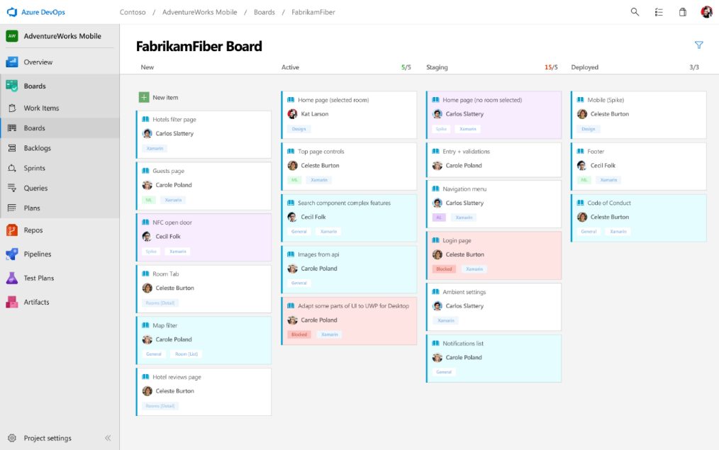
Deliver
Azure Boards
Azure Repos
Azure Pipelines
Connecting ideas to releases
Scrum ready to help your teams run sprints, stand-ups, and plan work
Integrated with GitHub commits and pull requests
Insights into project status and health
Azure Artifacts
Azure Test Plans

Slide 7
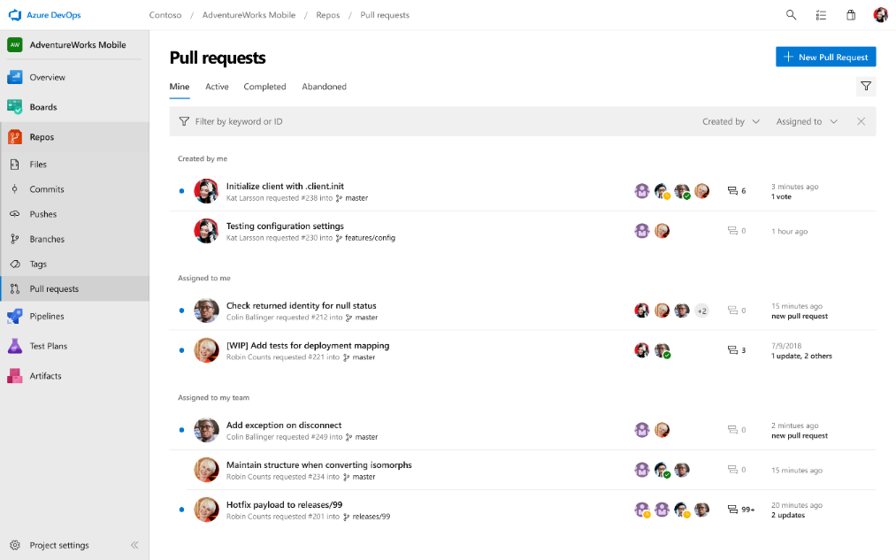
Deliver
Azure Boards
Azure Repos
Azure Pipelines
Private Git and TFVC repos for your teams
Code review via branch pull requests
Branch policies and build validation
Easy migration path to / from GitHub
Azure Artifacts
Azure Test Plans

Slide 8
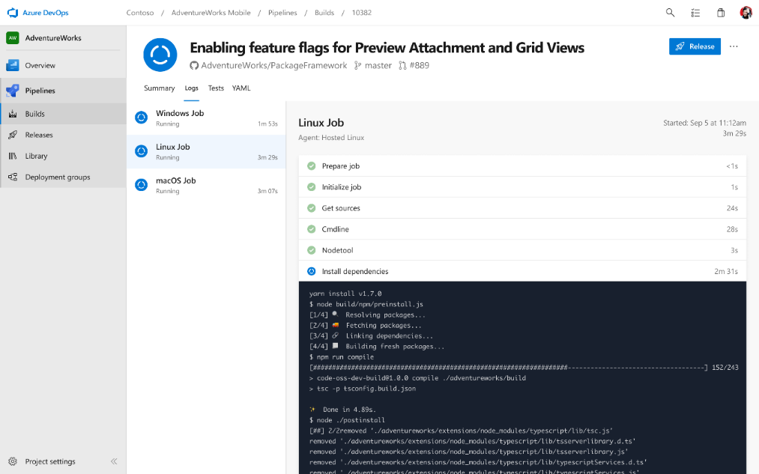
Deliver
Azure Boards
Azure Repos
Azure Pipelines
Cloud-hosted pipelines for Linux, macOS and Windows
Any language, any platform, any cloud
Native support for containers and Kubernetes
Best-in-class for open source
Azure Artifacts
Azure Test Plans

Slide 9
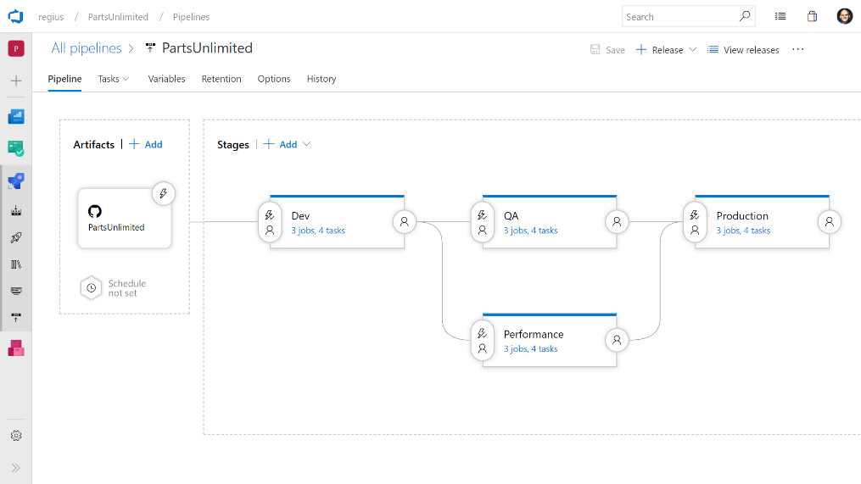
Deliver
Azure Boards
Azure Repos
Azure Pipelines
Deploy to on-premises, ANY cloud or a hybrid of cloud and on-prem
Staged environment releases
Pre and post deployment approvals with gates to automate approval based on conditions
Azure Artifacts
Azure Test Plans

Slide 10
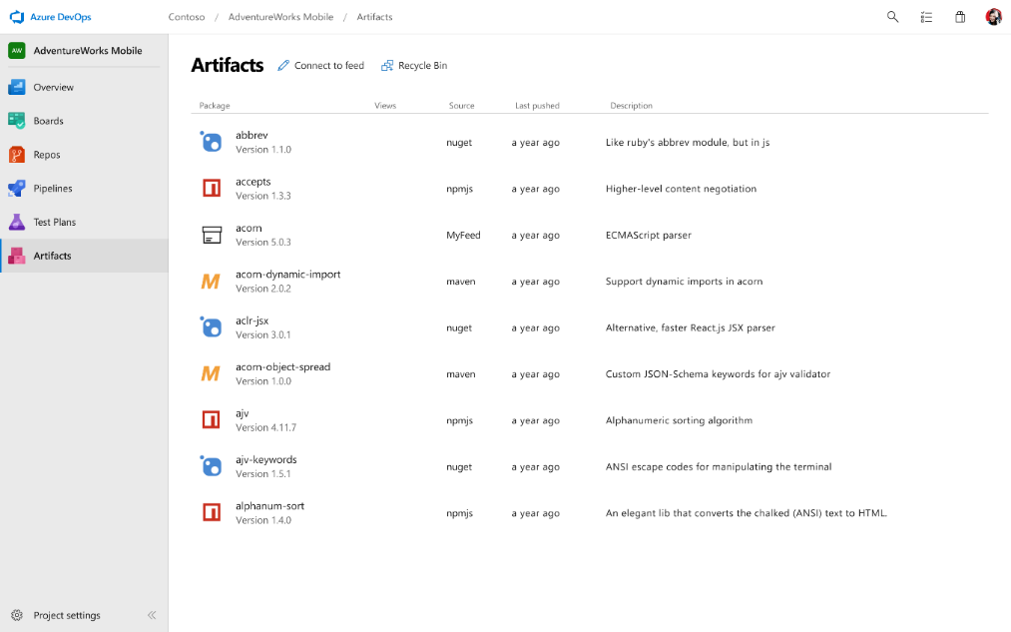
Deliver
Azure Boards
Azure Repos
Azure Pipelines
Share code efficiently
Keep your Maven, npm, NuGet and Python packages and more in the same place
Aggregate from public registries and internal teams
Publish and track from any pipeline
Azure Artifacts
Azure Test Plans

Slide 11
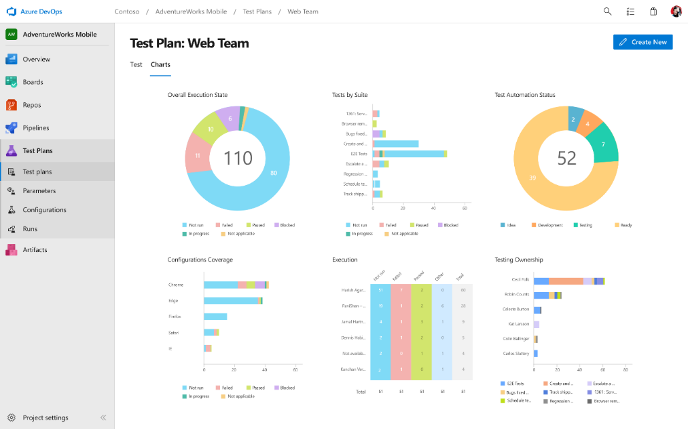
Deliver
Azure Boards
Azure Repos
Azure Pipelines
Run tests and log defects from your browser
Track and assess quality throughout your lifecycle
Capture rich data for reproducibility
Create tests directly from exploratory sessions
Azure Artifacts
Azure Test Plans

Slide 12

Azure DevOps
Continued heavy investment in Azure DevOps
Best in class CI/CD solution across the industry
Best & most loved solution for managing development teams
Tight integrations with GitHub
Provide enterprise scalable package management
➔
https://azure.com/devops

Slide 13


Session Feedback Your Time & Opinion is Valued
https://www.telerik.com/devreach/day1feedback

